Slide 1
CSE 220
Jannatun Noor
Jannatun.noor@bracu.ac.bd
Lecture Made by: Aminul Huq

Slide 2
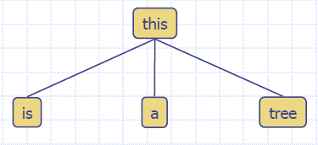
What is a Tree
In computer science, a tree is an abstract model of a hierarchical structure
A tree consists of nodes with a parent-child relationship
Applications:
Organization charts
File systems
Programming environments

Slide 3
What is a Tree
A connected acyclic graph is a tree
A tree T is a set of nodes in a parent-child relationship with the following properties:
T has a special node r, called the root of T, with no parent node
Each node v of T, different from r, has a unique parent node u
A tree cannot be empty, since it must have at least one node – the root.

Slide 4
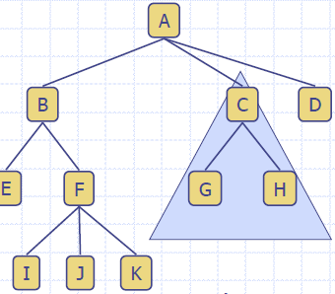
Tree Terminology
Root: node without parent (A)
Internal node: node with at least one child (A, B, C, F)
External node (Leaf ): node without children (E, I, J, K, G, H, D)
Ancestors of a node: parent, grandparent, grand-grandparent, etc.
Descendants of a node: child, grandchild, grand-grandchild, etc.
Depth of a node: number of ancestors, excluding the node itself
Height of a tree: maximum depth of any node (3)
Siblings: two nodes that are children of the same parent
Subtree: tree consisting of a node and its descendants

Slide 5
Depth and Height
The depth of a node v can be recursively defined as follows
If v is the root, then the depth of v is 0.
Otherwise, the depth of v is one plus the depth of the parent of v
Algorithm depth(T, v)
if T.isRoot(v) then
return 0
else
return 1 + depth(T, T.parent(v))

Slide 6
Depth and Height
The height of a node v can be recursively defined as follows
If v is a leaf node, then the height of v is 0.
Otherwise, the height of v is one plus the maximum height of a child of v
The height of a tree T is the height of the root of T
The height of a tree T is equal to the maximum depth of a leaf node of T
Algorithm height1(T)
h = 0
for each v εT.positions(v) do
if T.isExternal(v) then
h = max(h, depth(T, v))
return h

Slide 7
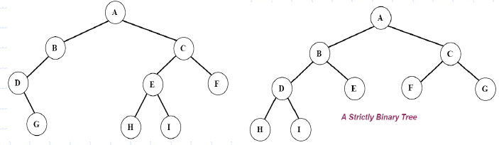
Ordered Trees
A tree is ordered if there is a linear ordering defined for each child of each node.
A binary tree is an ordered tree in which every node has at most two children.
If each node of a tree has either zero or two children, the tree is called a proper (strictly) binary tree.

Slide 8
Traversal of Trees
A traversal of a tree T is a systematic way of visiting all the nodes of T
Traversing a tree involves visiting the root and traversing its subtrees
There are the following traversal methods:
Preorder Traversal
Postorder Traversal
Inorder Traversal (of a binary tree)

Slide 9
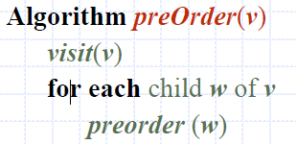
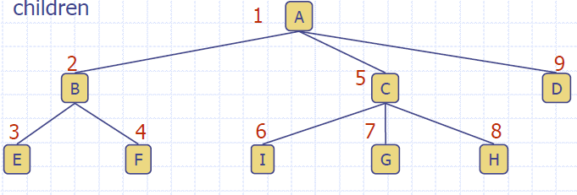

Preorder Traversal
In a preorder traversal, a node is visited before its descendants
If a tree is ordered, then the subtrees are traversed according to the order of the children

Slide 10
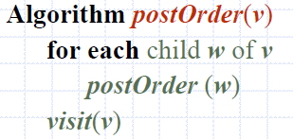
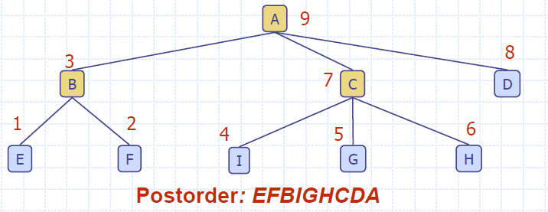
Postorder Traversal
In a postorder traversal, a node is visited after its descendants

Slide 11
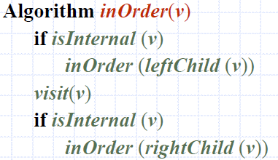
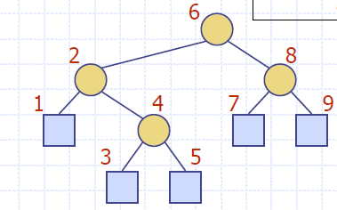

Inorder Traversal
In an inorder traversal a node is visited after its left subtree and before its right subtree

Slide 12
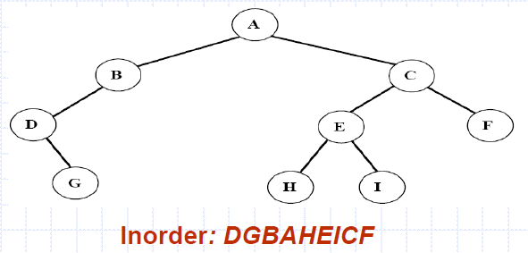
Inorder Traversal
Traversing a binary tree in inorder
Traverse the left subtree in inorder.
Visit the root.
Traverse the right subtree in inorder.

Slide 13
Binary Tree
A (proper) binary tree is a tree with the following properties:
Each internal node has two children
The children of a node are an ordered pair
We call the children of an internal node left child and right child Alternative recursive definition: a (proper) binary tree is either
a tree consisting of a single node, or
a tree whose root has an ordered pair of children, each of which is a binary tree
Applications:
arithmetic expressions
decision processes
searching

Slide 14
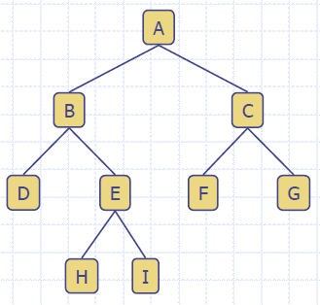

Slide 15
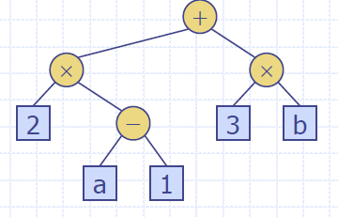
Arithmetic Expression Tree
Binary tree associated with an arithmetic expression
internal nodes: operators
external nodes: operands Example: arithmetic expression tree for the expression (2 * (a - 1) + (3 * b))

Slide 16
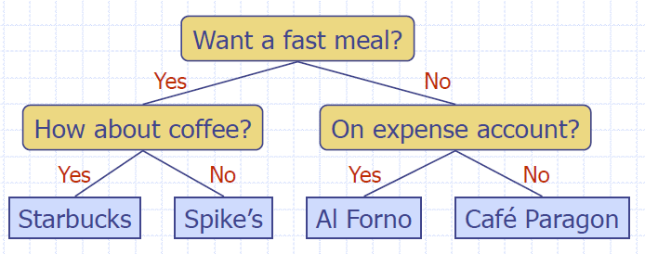
Decision Tree
Binary tree associated with a decision process
internal nodes: questions with yes/no answer
external nodes: decisions Example: dining decision

